Slide 1



Quantum Mechanical Arrival Time Distributions In Free Fall Experiments Across Opaque Barriers
Bachelor In Physics - Thesis Defense
Adam Blazejczak 27 May 2025
Promotor: Ward Struyve · Co-Promotor: Jef Hooyberghs · Contributions: Siddhant Das

Slide 2
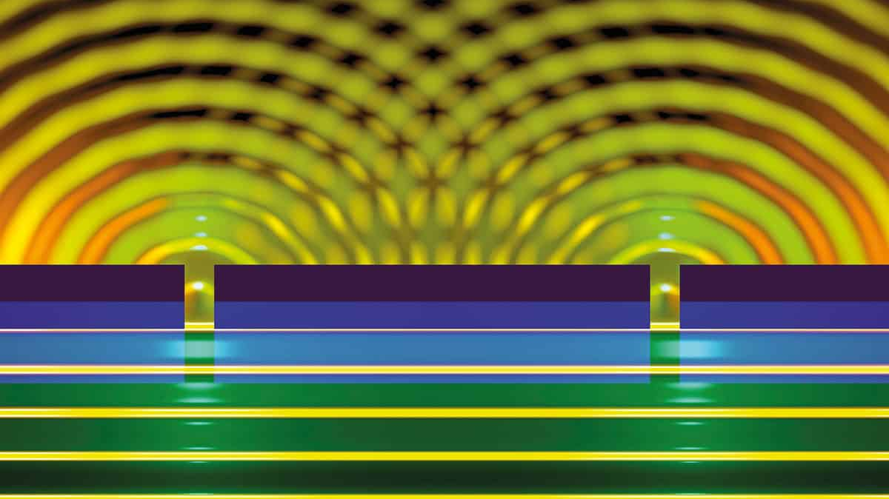
Source: https://physicsworld.com/a/double-slits-with-single-atoms/

Slide 3
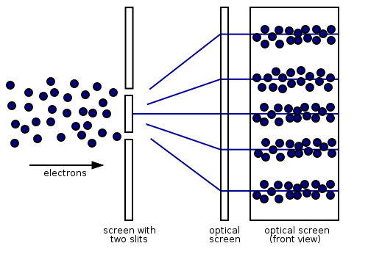
The Famous Double Slit Experiment
“If you can explain the double-slit experiment without getting dizzy, you don’t understand it.” - Jim Al-Khalili

Slide 4
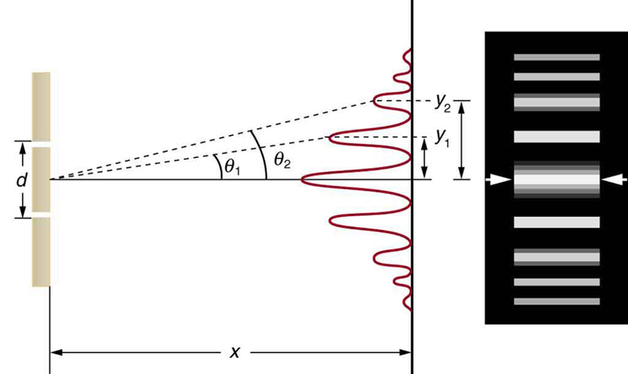
Canonical Quantum Formalism = What we’ll Measure

Slide 5

To get a full picture of QM, one may ask When will a Quantum Particle Arrive?

Slide 6
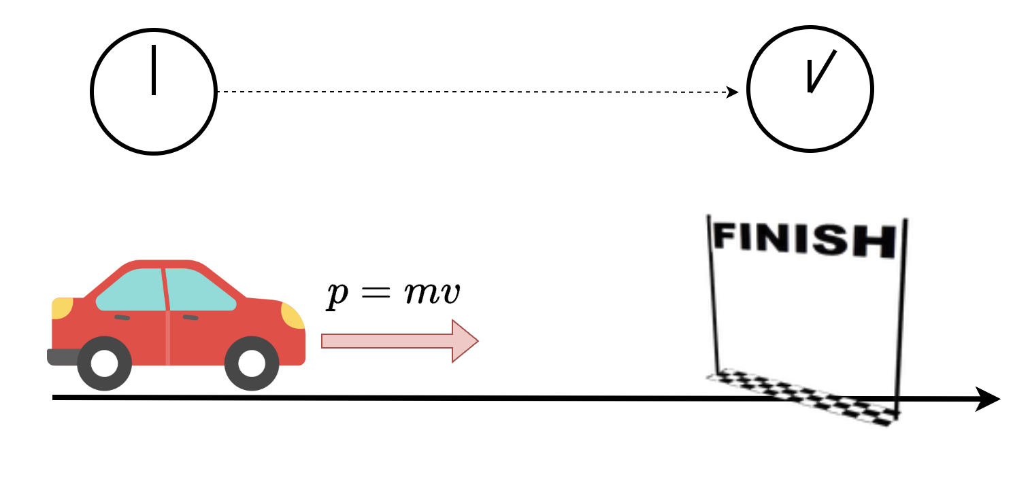
Classic Time of Arrival = Errors Due To Lack of Knowledge

Slide 7
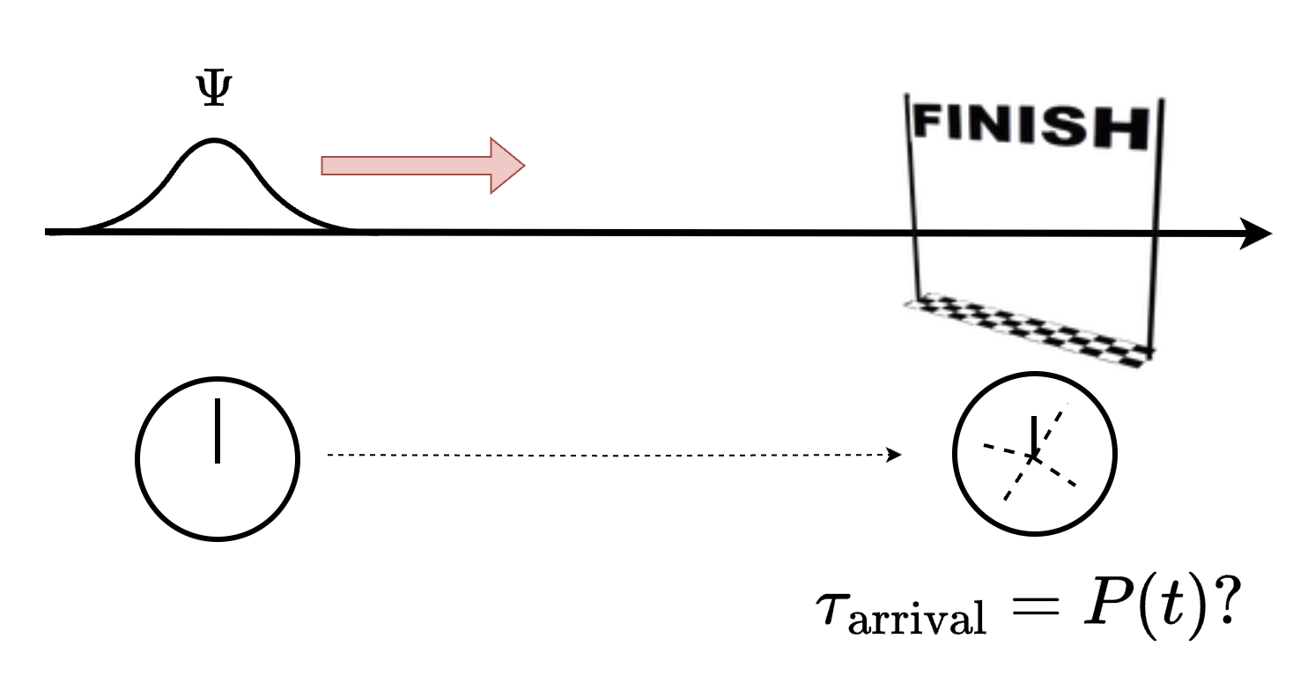
Quantum Time of Arrival = Inherent Uncertainty

Slide 8
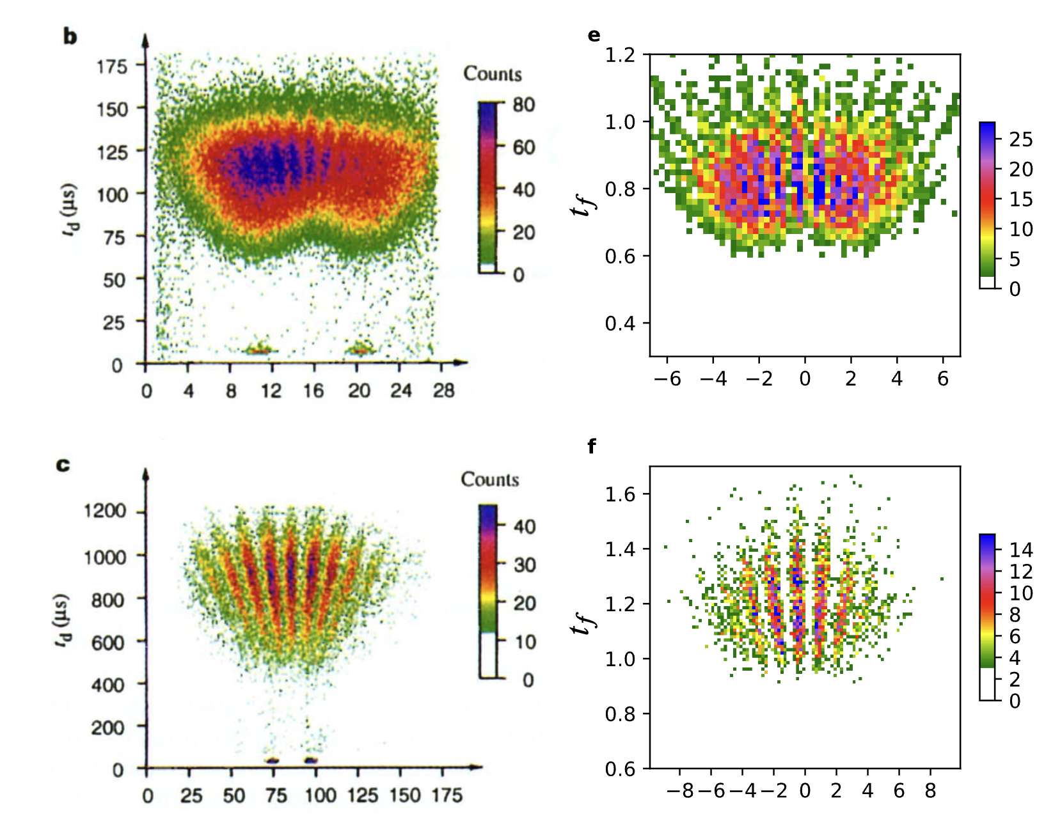
Time of Arrival In Experiments
He Atoms Through Dual Slit
Numerical Simulations using Bohmian Mechanics
x
x
Source: Double-slit experiment remastered - Das, Deckert, Kellers, 2022

Slide 9
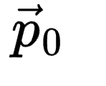
Ambiguity When Measuring Time of Arrival In Experiments
“Spreading” of Arrival Time
due to uncertainty on initial momentum
Different Type of Experiment?

Slide 10
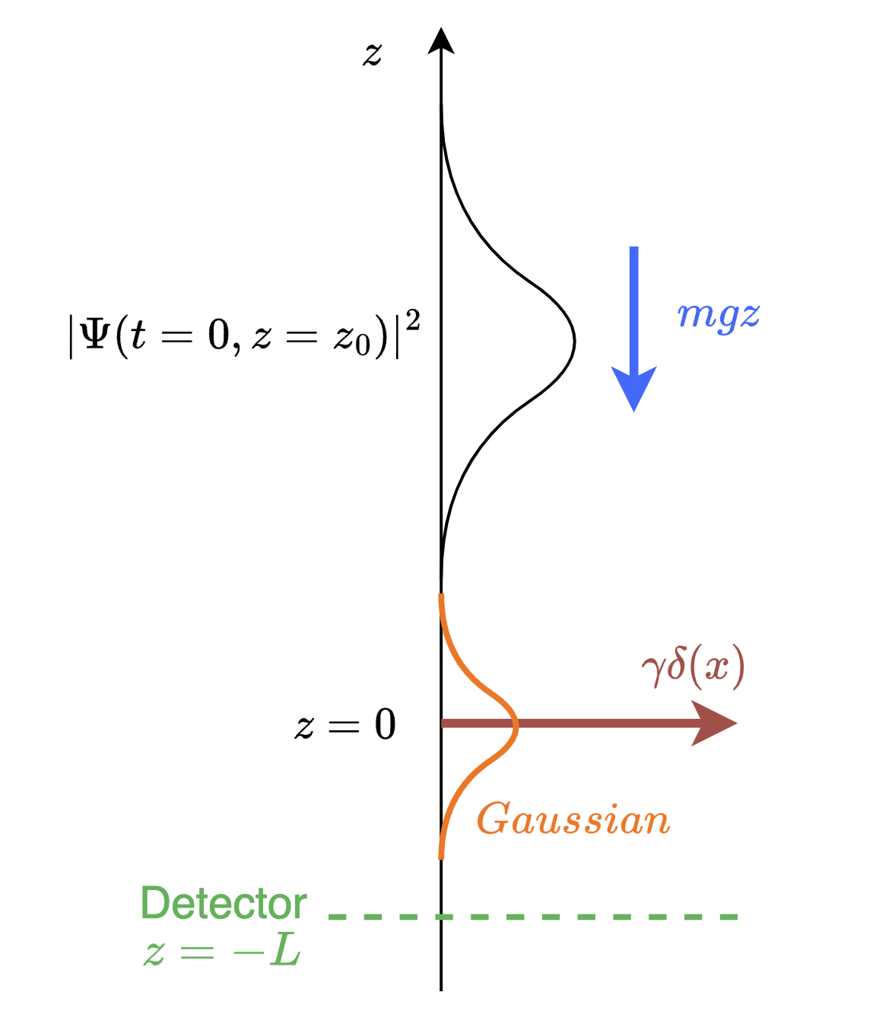
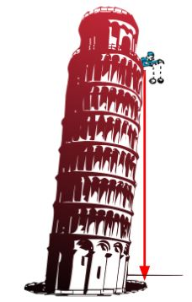
Experimental Idea
Free Fall of Quantum Particle Onto Barrier
Use Case
Particle At Rest Exact Initial Conditions
Quantum Tunneling = Non-Classical Solutions
Hypothetically physically realizable*
Precise Time of Arrival Predictions
* See ultra-cold neutron experiments in free fall

Slide 11
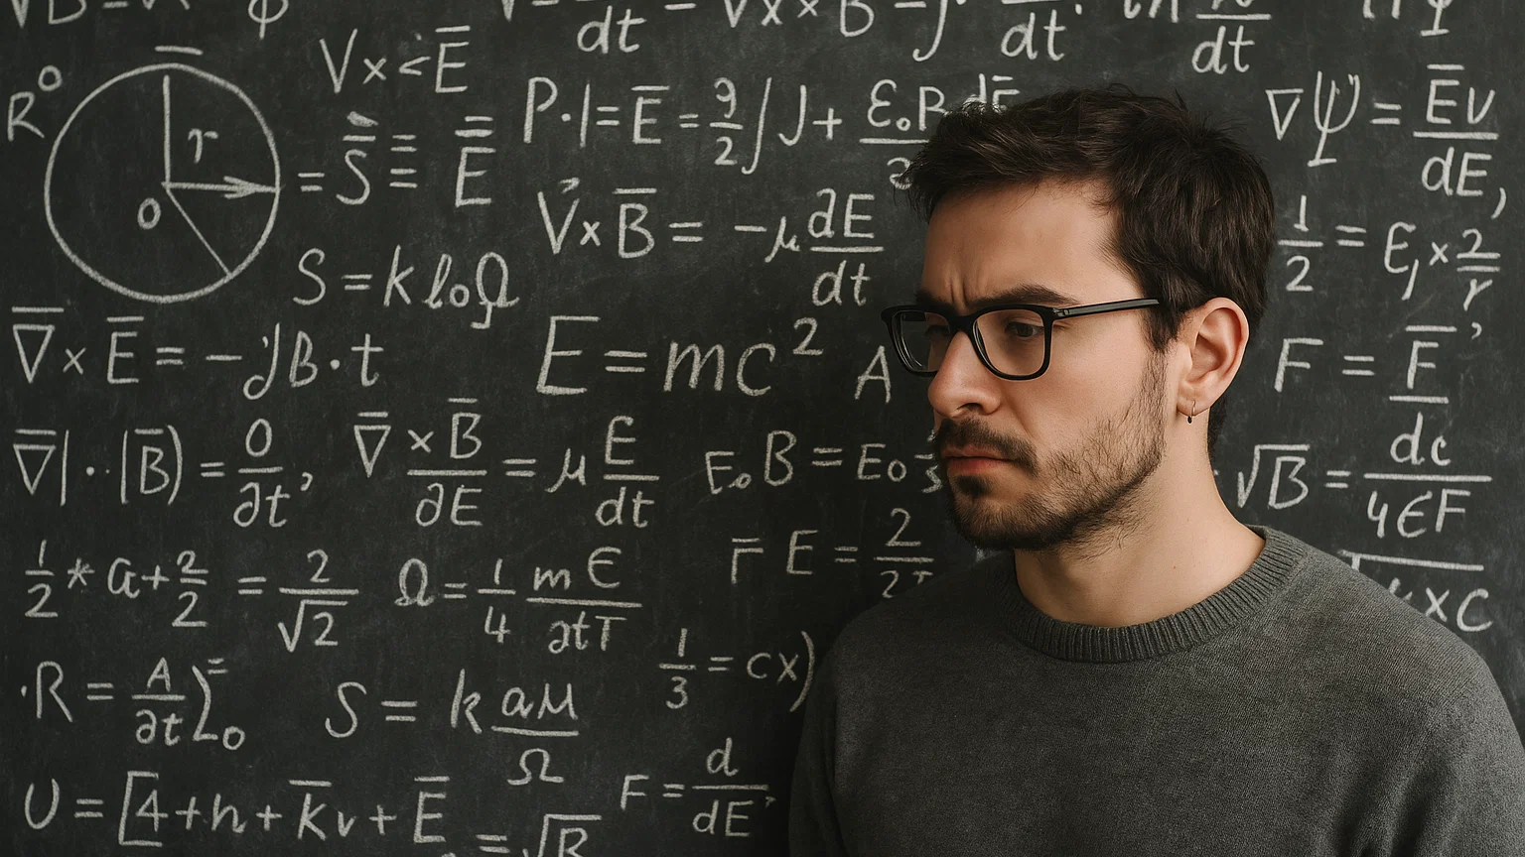
Putting It All Together

Slide 12
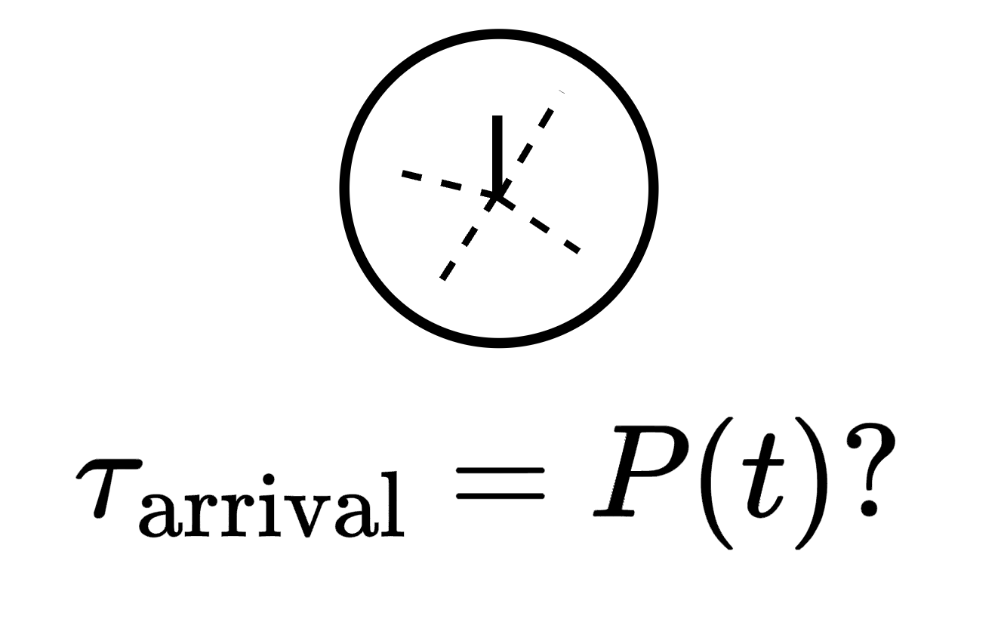
Experiments done on DSE have Initial Condition Problems. Measurements align with numerical simulations
We propose a physically realizable Free Fall experiment to solve this.
This study is a first analysis using Numerical Methods.
We want to study Arrival Time of Quantum Mechanical Particles

Slide 13
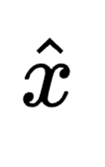
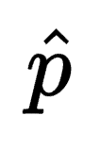
There’s One Big Problem
Time Operators / Arrival Times are not defined in Canonical Quantum Formalism!
No position or momentum before measurement! The Measurement Problem

Slide 14

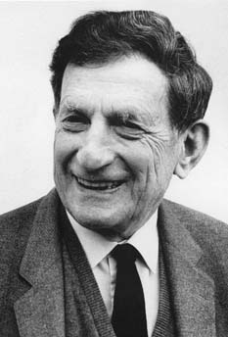
For this we’ll need
David Bohm
Bohmian Mechanics
1917 - 1992

Slide 15
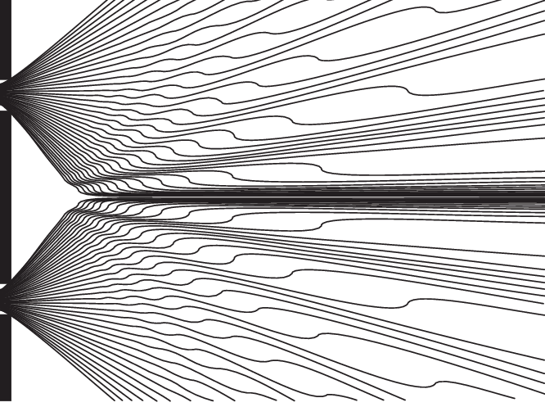
Bohmian Mechanics - Pilot Wave Theory
Schrödinger Equation = Yes Wave Function = Yes
Particles? 1. Are Dot-like entities 2. Guided by a pilot wave
3. Have a Definite Velocity
→ Bohmian Trajectories

Slide 16
Same Predictions - Different Formalism
Bohmian Mechanical View
Canonical Quantum Formalism

Slide 17
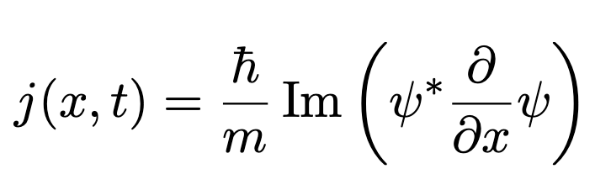
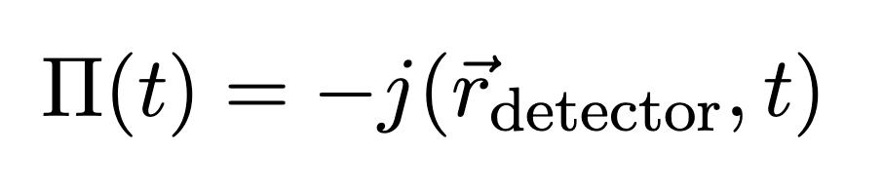
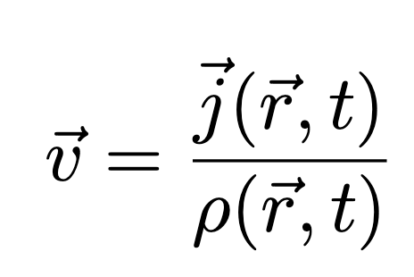
Bohmian Trajectories To Arrival Time
Probability Current (Flux)
Arrival Time Per Unit Time
Bohmian Trajectories justify the use of strictly positive probability current

Slide 18
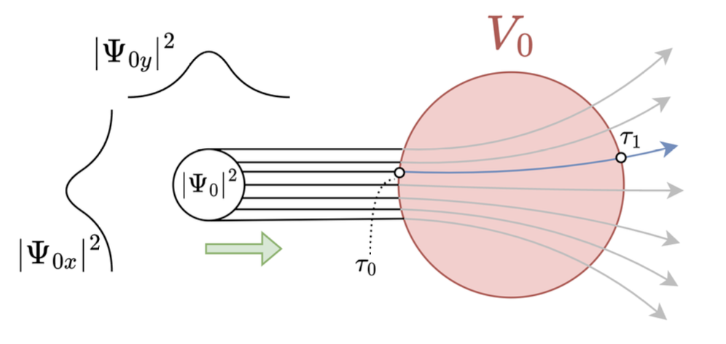
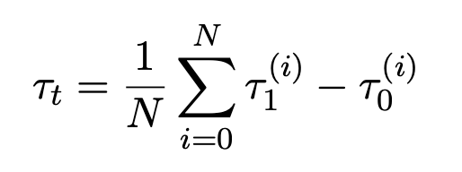
Tunneling Time via Bohmian Trajectories

Slide 19
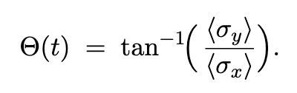
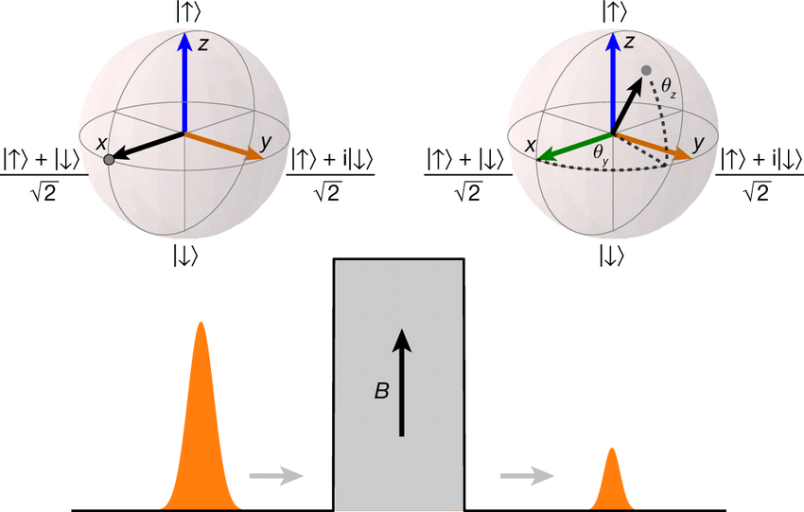
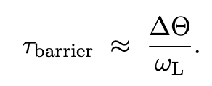
Bohmian Tunneling Time vs Larmor Clock
Source: Measurement of the time spent by a tunnelling atom within the barrier region – Ramos et al, 2020

Slide 20

Results

Slide 21
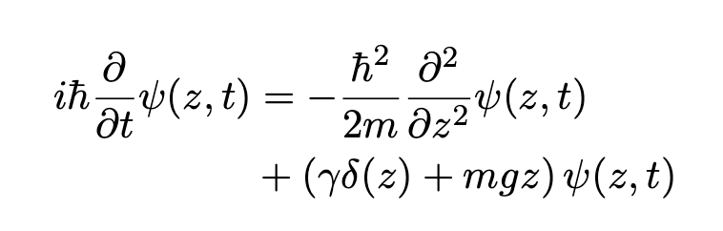
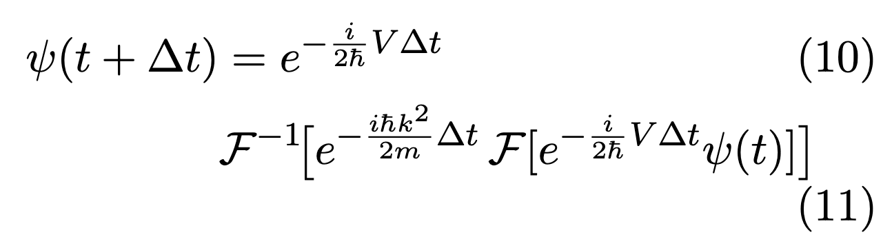
Arrival Time - Setup 1 – Free Fall With Barriers
Schrödinger Equation
Barrier
Linear Gravitation Potential
Split Operator Method - 𝓞(dt³)
Fast Fourier Transform
Yoshida Method - 𝓞(dt⁵)

Slide 22
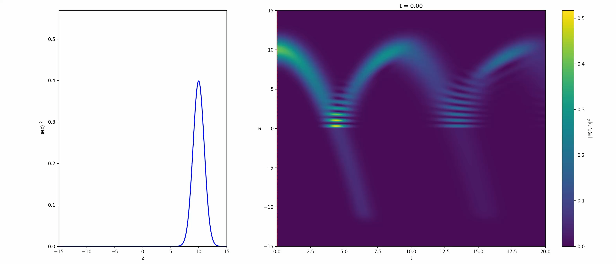
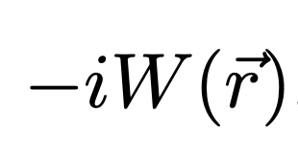
1D Simulation using Yoshida Method with 𝓞(dt⁵) error
Detector
Detector
Python + Numpy + Scipy
Complex Absorbing Potential to absorb ψ at edge

Slide 23
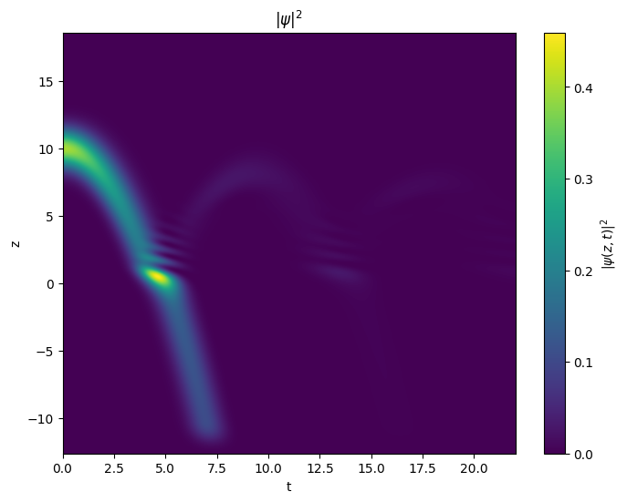
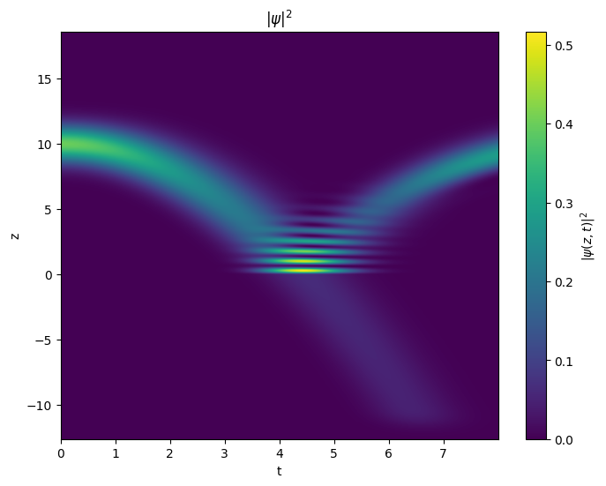
Gaussian Barrier
Delta Barrier
Python + Numpy + Scipy Nx=2048 dt=0.001 zϵ[-40,40] 50k steps

Slide 24
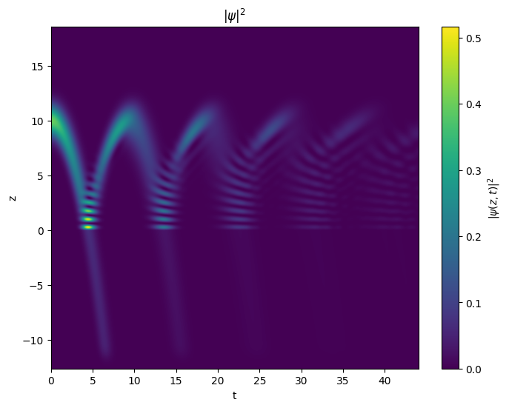
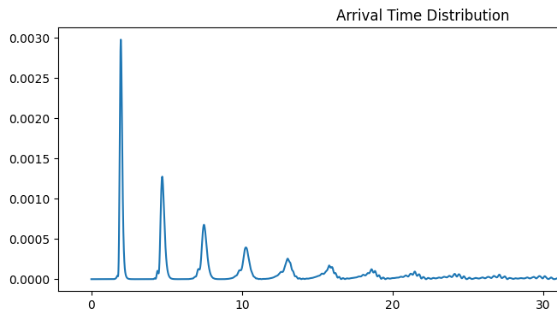
Probability / Unit Time (s⁻¹)
Time (s)

Slide 25
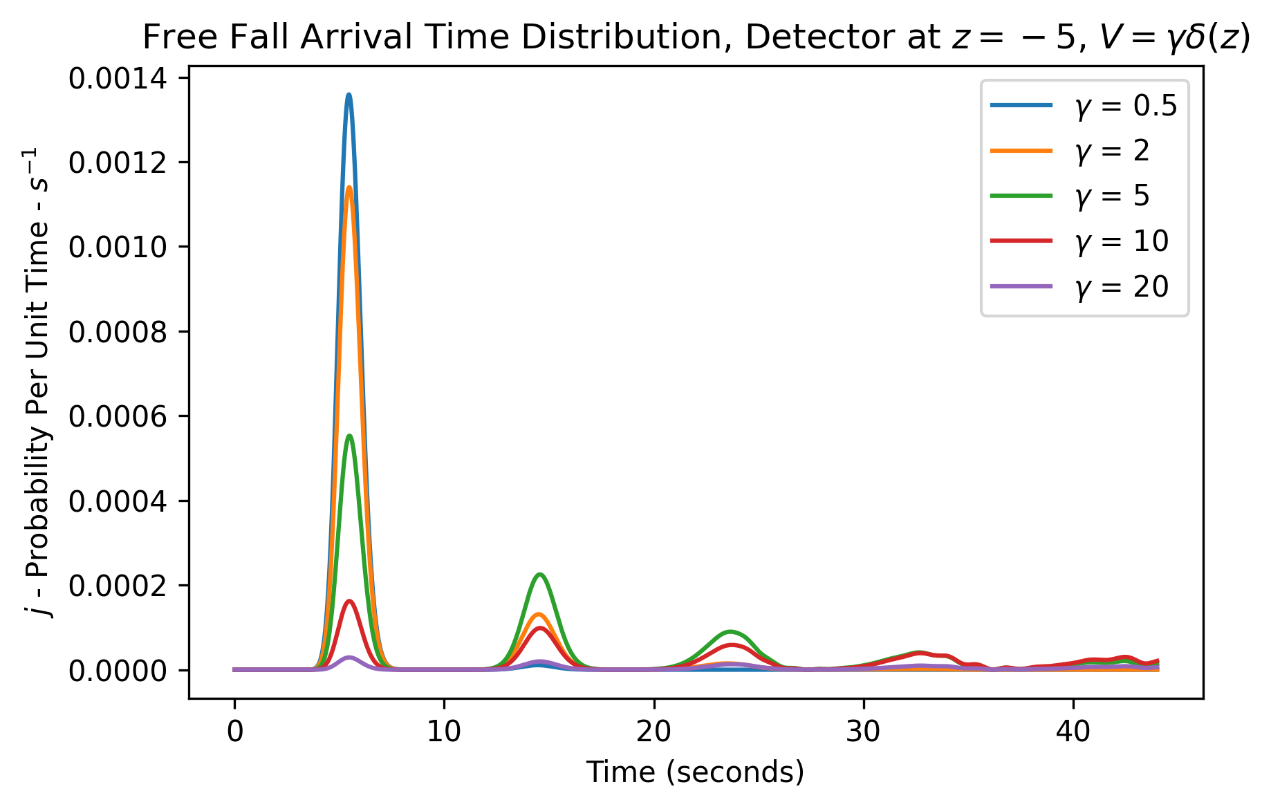

Slide 26
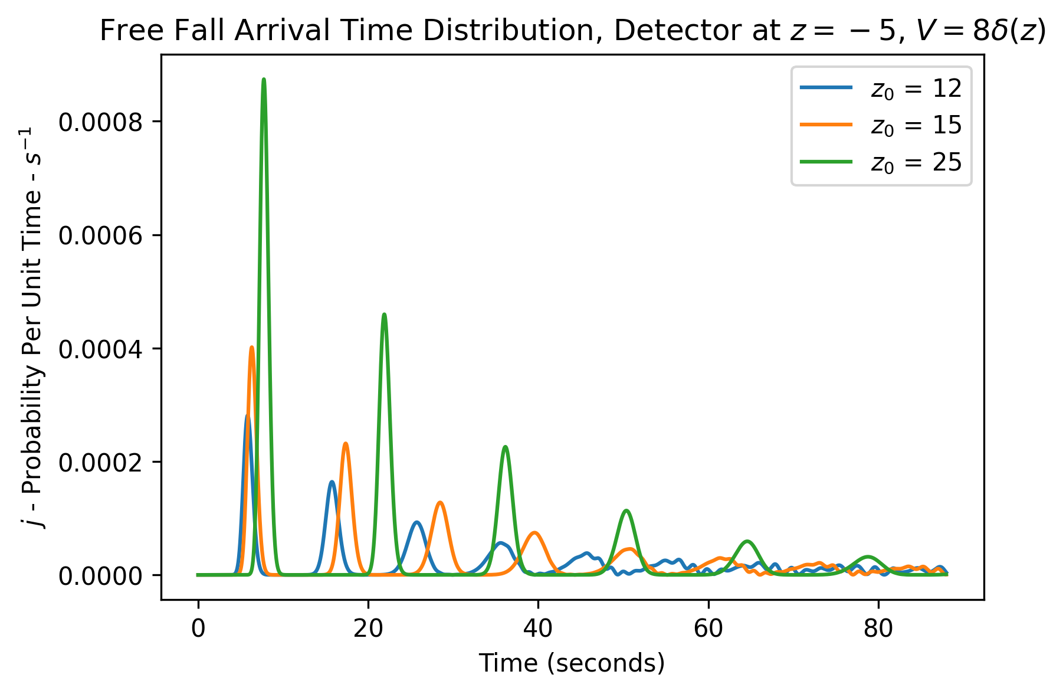

Slide 27
Analysis of Arrival Time Peaks
Arrival Time Peaks in seconds (s)
0.5𝛄
2𝛄
5𝛄
10𝛄
Barrier Strength

Slide 28
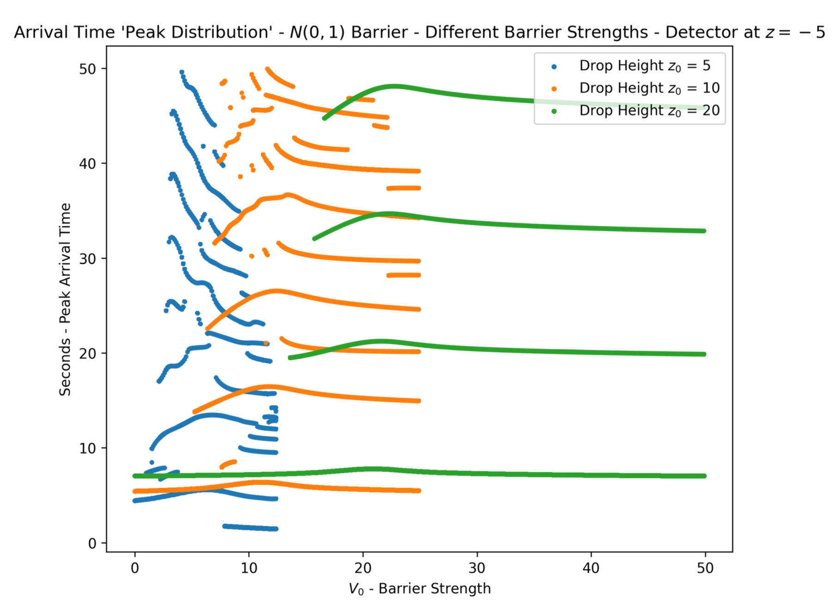
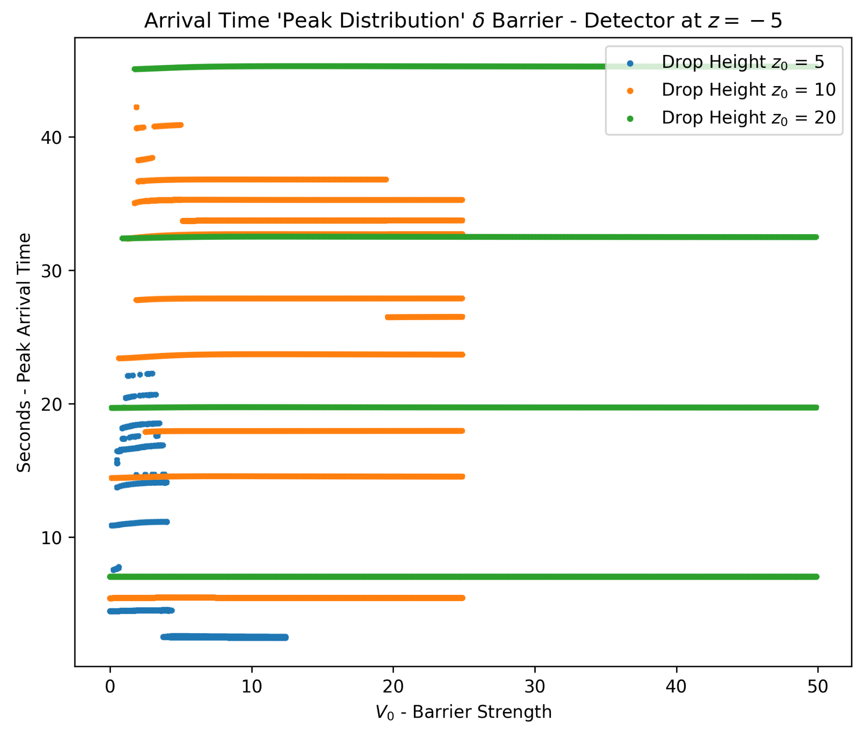
Band Formation
Gaussian Barrier
Delta Barrier
Stabilization For Strong Barriers
Non-Linear Arrival Time
Tunneling Resonances

Slide 29
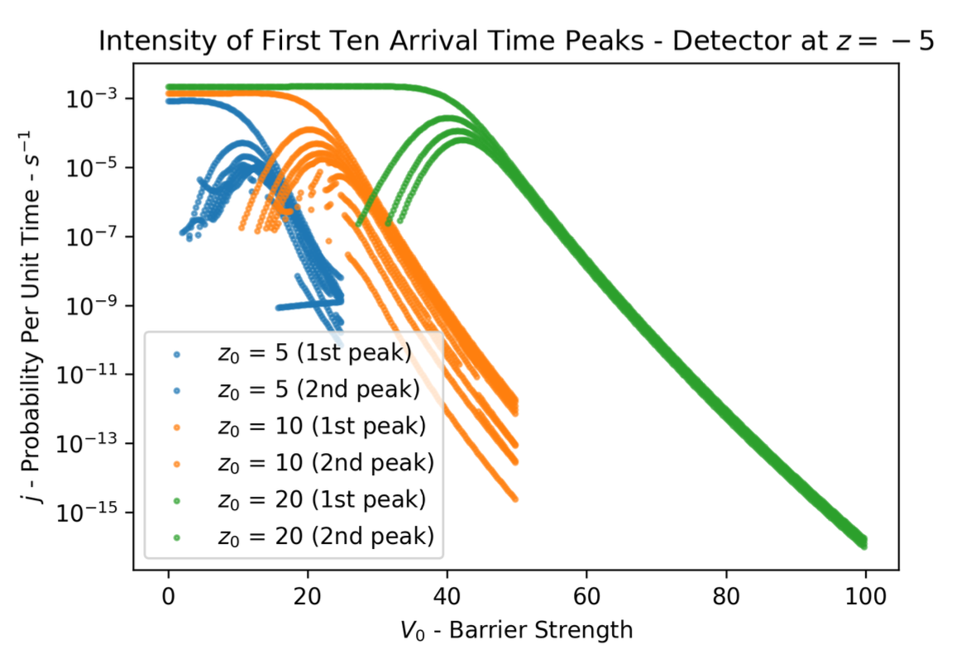
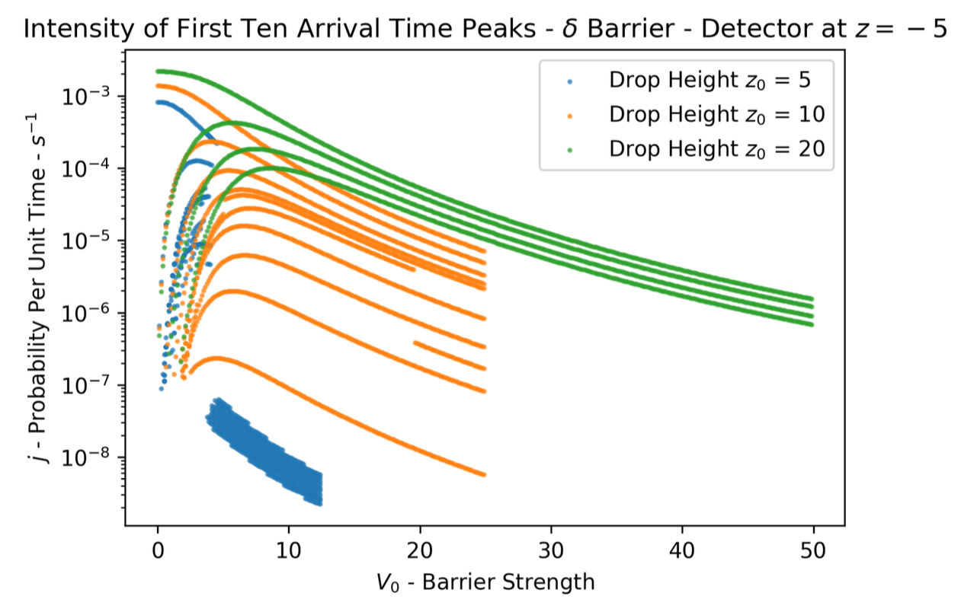
Arrival Time Peak Intensity vs Barrier Strength
Gaussian Barrier
Delta Barrier

Slide 30
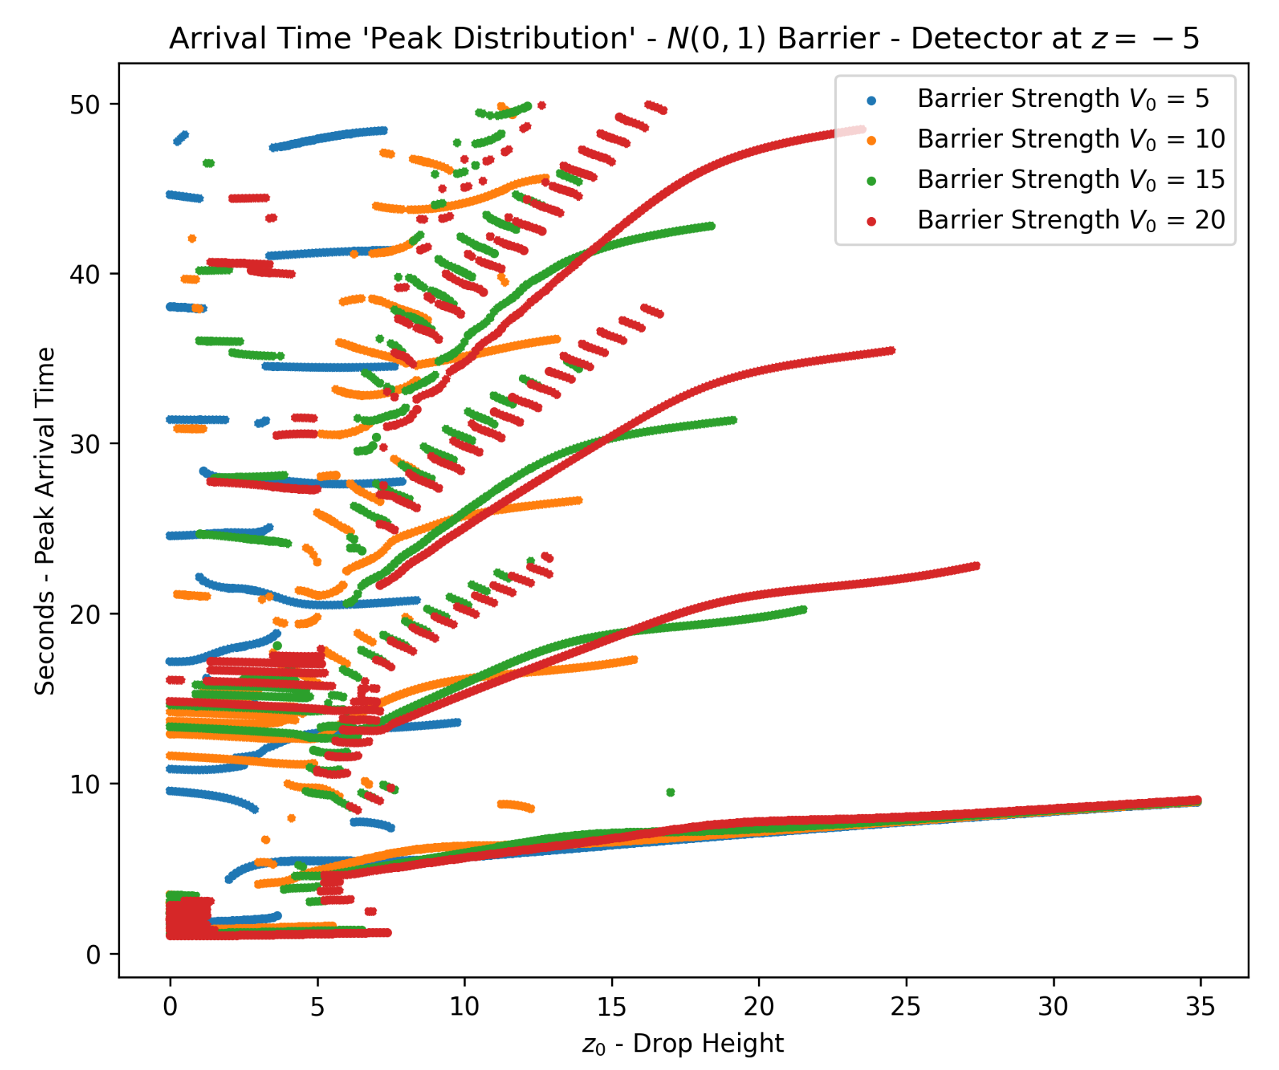
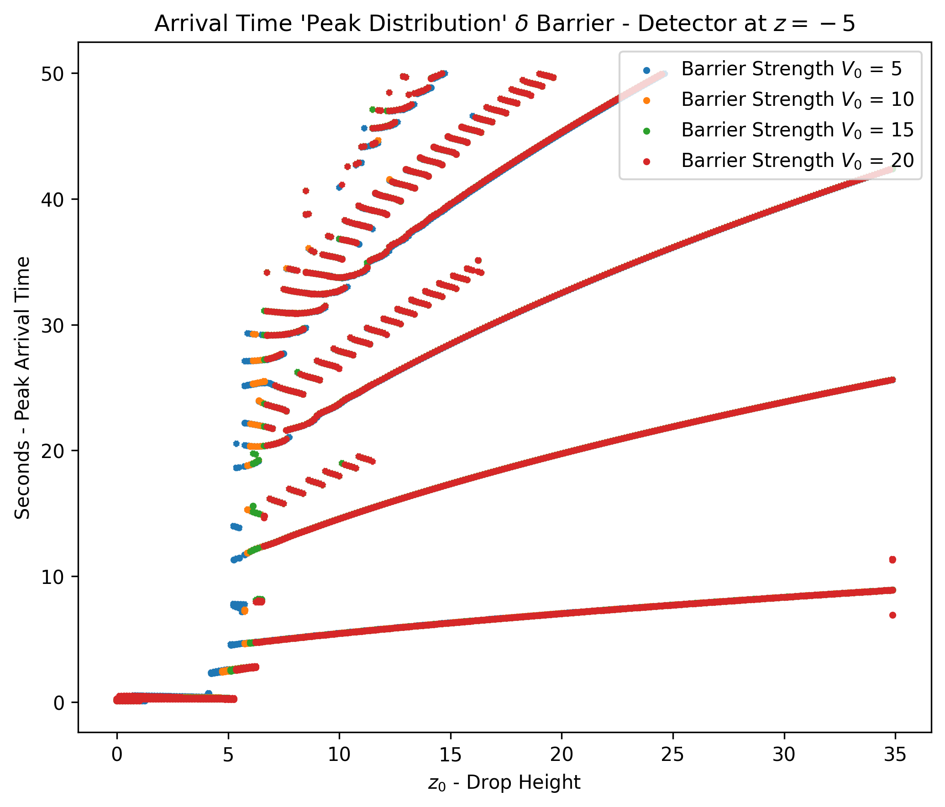
Arrival Time Peak Time vs Drop Height
Gaussian Barrier
Delta Barrier

Slide 31
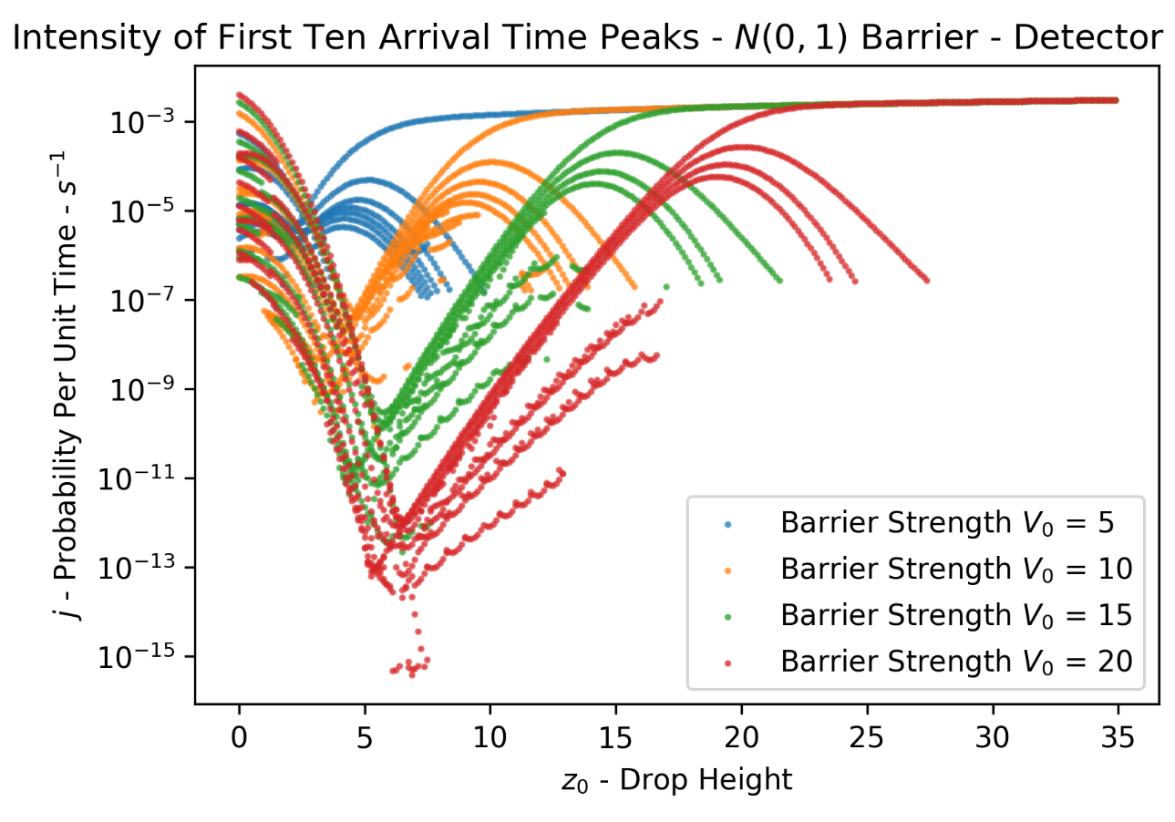
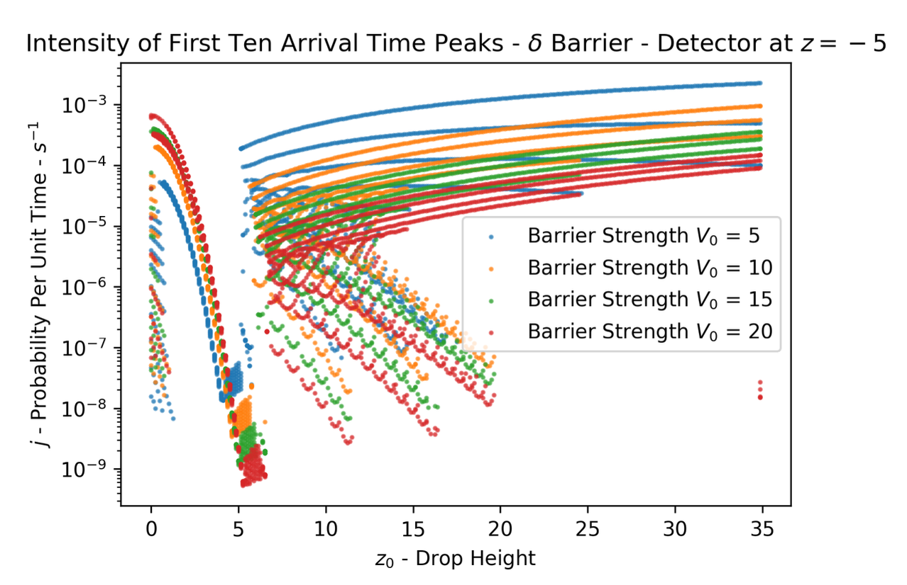
Arrival Time Peak Intensity vs Drop Height
Gaussian Barrier
Delta Barrier

Slide 32
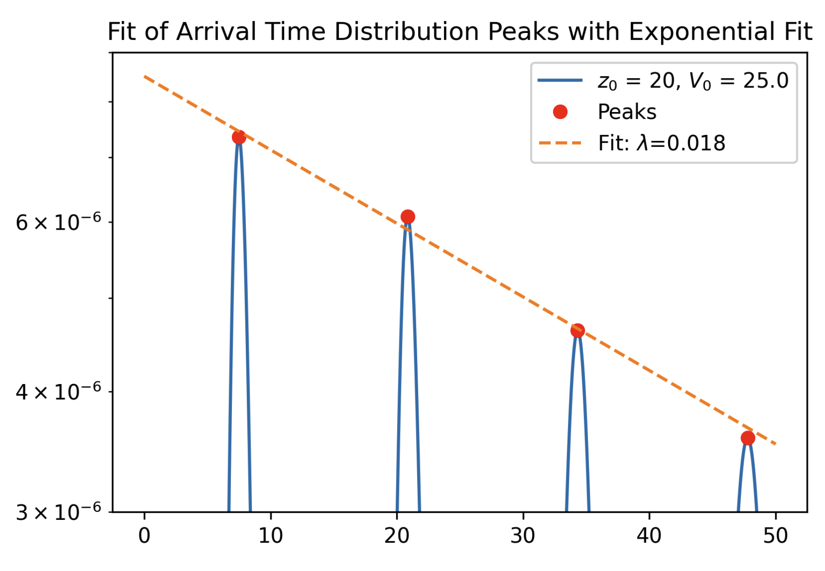
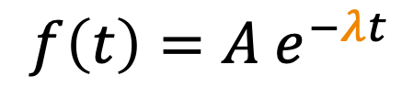
Fitting of Arrival Time Peaks Decay
$${f\left(t\right)=A e}^{−λt}$$
Probability Per Unit Time (1/s)
Seconds (s)

Slide 33
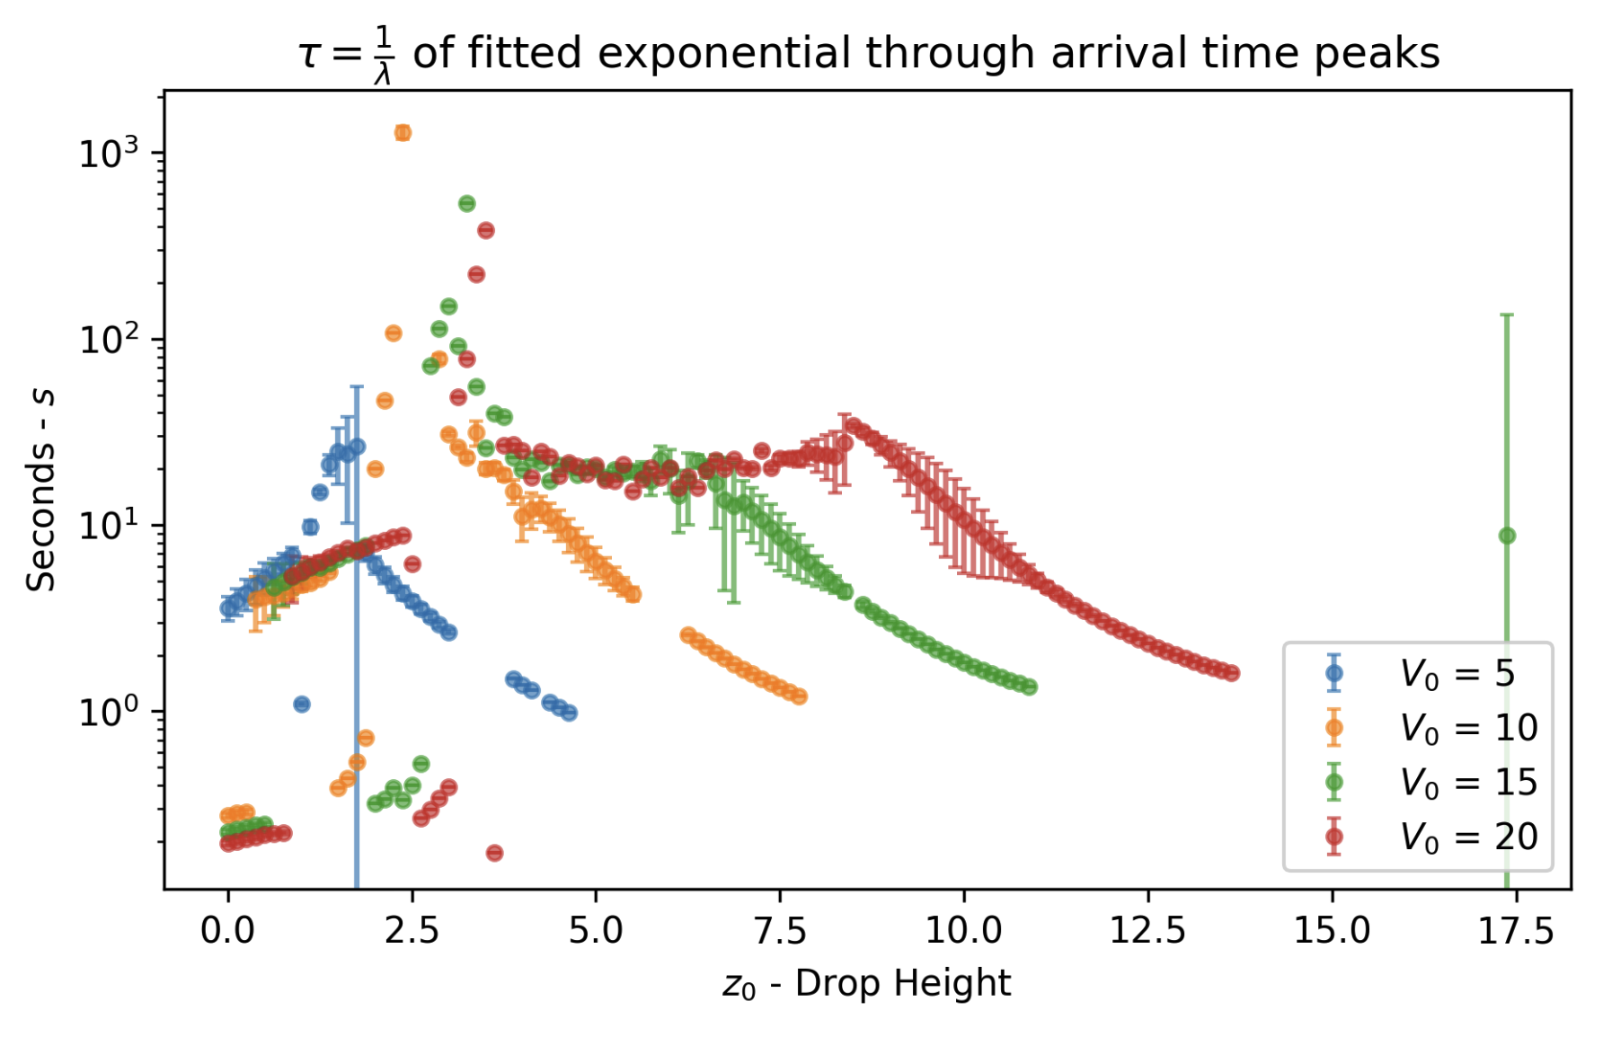
Fitted 𝝉=1/𝜆 ~ Mean Dwelling Time of ψ ?

Slide 34
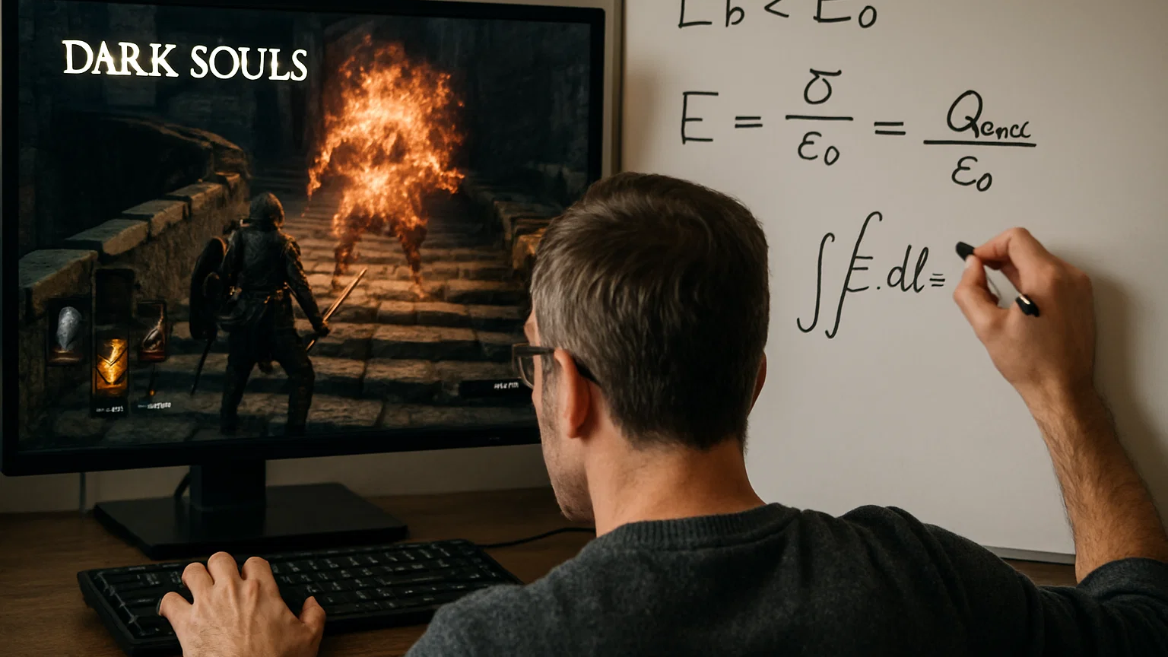
Speed Running Other Results
Notes:
From here on, I have 2 more minutes usually until 15 minutes

Slide 35
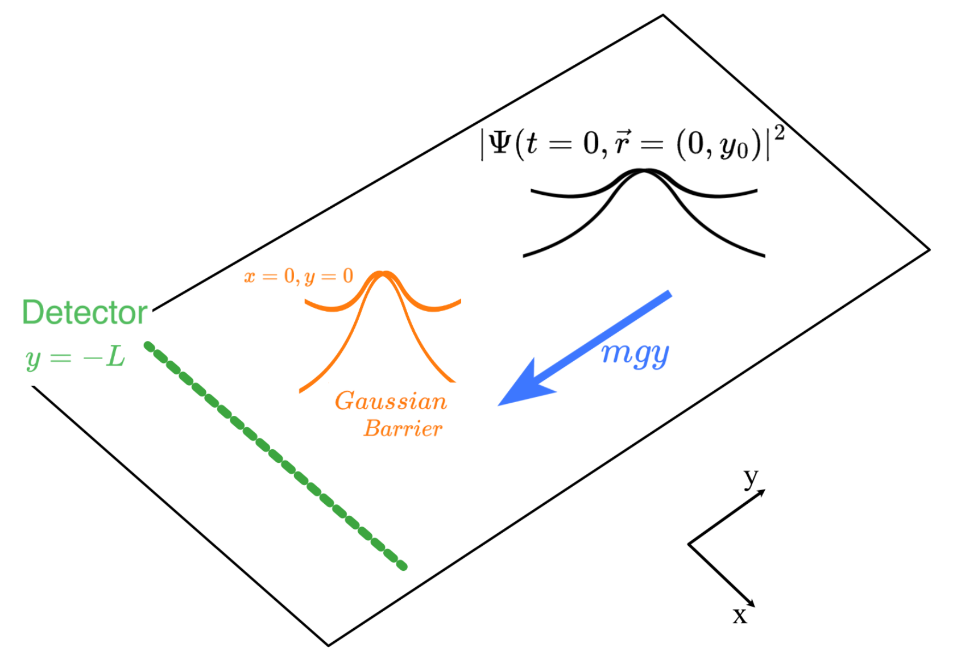
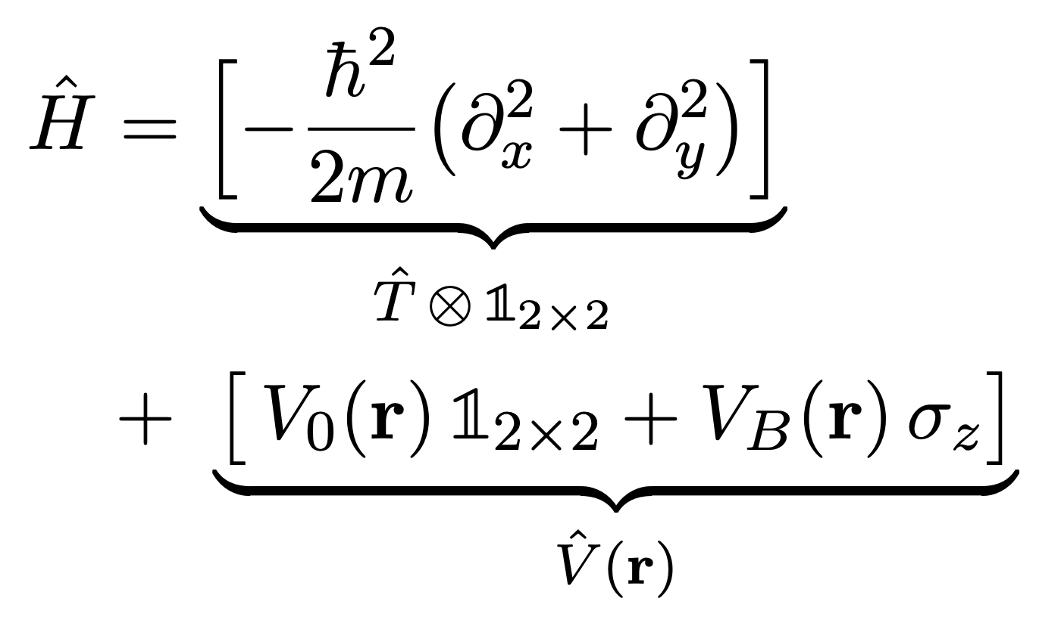
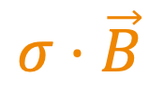
Free Fall 2D Setup Spin ½ Particles + Magnetic Barrier
$$σ⋅\vec{B}$$

Slide 36
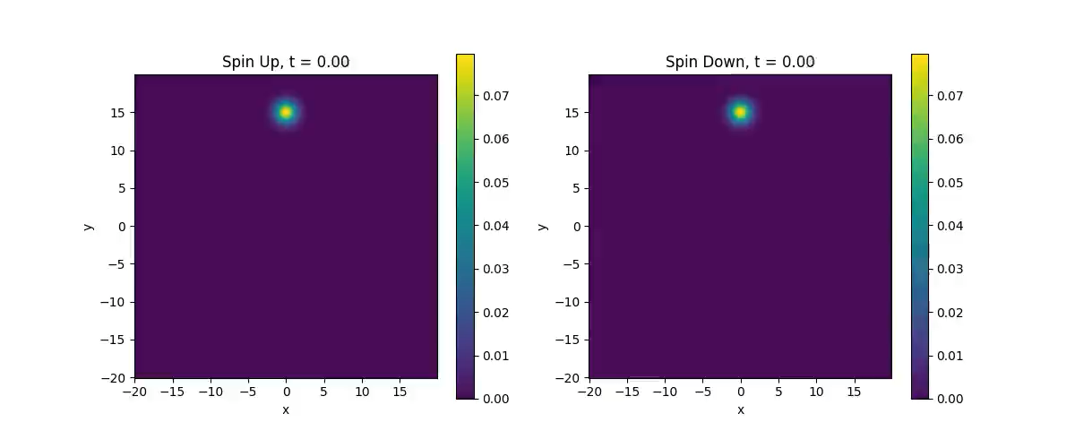
Strong Circular Magnetic Barrier

Slide 37
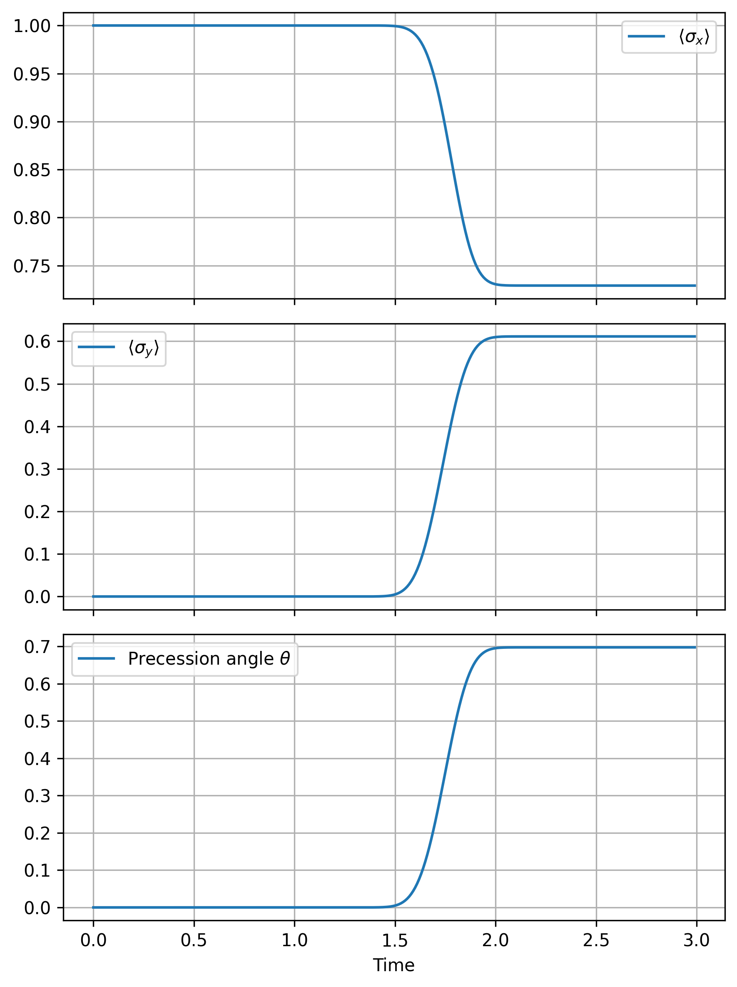
Larmor Clock - Spin Precession Calculation

Slide 38



Bohmian Trajectories to Tunneling Time
Notes:
15 Seconds

Slide 39




Larmor Clock ≈ Bohmian T_{tunnel} in weak barrier regime
Larmor Clock ≠ Bohmian in weak barrier regime
Larmor
0.1726 ± 1.51e-06 s
Bohmian
0.1709 ± 2.78e-17 s
Larmor
Notes:
15 Seconds

Slide 40


Where does a Gaussian even begin?
Bohmian Trajectory
2R = 2 ln 2 σ (FWHM) Experimentalist’s
Laser Beam Width
2R = 3 σ
Regions Inside Barrier
Notes:
15 Seconds

Slide 41
Conclusions
Analysis of Arrival Time Distributions using Bohmian Mechanics in new experiment proposal
Succesful Simulations of Quantum Systems using Yoshida Method
Larmor’s Clock ≠ Bohmian Theory for Tunneling Time
✓ Non-Linear Arrival Time
✓ 450Gb of Data Produced
✓ Band Formation
✓ Square Barrier = Ok
✓ Simulation Automation
✓ Gaussian Barrier = Not Ok
✓ Tunneling Resonances
✓ Modest Use of Resources
Next: Experimental Verification & Theoretical Treatment

Slide 42
One more thing...

Slide 43


Quantum Arrival Times on your Phone
App - https://quantum-arrival-time.netlify.app/
Code - https://github.com/adamblvck/quantum-arrival-time-bachelor-thesis/

Slide 44

Q&A
https://quantum-arrival-time.netlify.app/

Slide 45

Appendix 0

Slide 46
Appendix 0.1
1D Simulations
Nx = 1028
dt = 0.001
50000 timesteps
x in [-40, 40]
2D Simulations
Nx, Ny = 512
dt = 0.01
300 timesteps
x in [-20, 20]

Slide 47

Appendix 0.2

Slide 48

Appendix 0.3 – Pauli’s No-Go Theorem

Slide 49

Appendix 0.4 – Semi Classical Arrival Time
$$τ_{arrival}≈\frac{L}{<v>} with<v> = \frac{\hat{p}}{m}$$
Works exceedingly well when no opaque barriers are in place. This is at a high level how LHC performes “arrival time of protons” by assuming macroscopic & relativistic beams

Slide 50



Appendix 0.5 – 2D Simulations

Slide 51




Appendix 1

Slide 52


Appendix 1

Slide 53

Appendix 0.1 – 1D Barrier Definitions

Slide 54

Appendix 2 - Split Operator Method - Numerical Simulations

Slide 55

Appendix 3 - Tunneling Time Through Barrier Using Larmor Clocks
This is a classical approach.

Slide 56

Appendix 4 – Simulation Workflow

Slide 57

Appendix 5 – Split Operator Method

Slide 58




Appendix 6 – Yoshida Method

Slide 59

Appendix 7 – Comparison Between dt³ and dt⁵

Slide 60

Appendix 7 – Comparison Between dt³ and dt⁵

Slide 61



Appendix 8 – Complex Absorption Potentials
Add To Hamiltonian:

Slide 62


Choosing Absorption Potentials
No Absorption -> Reflection
With Absorption

Slide 63




No or reflecting (bad) Absorption Layer
With Best Fit Absorption Layer

Slide 64



Absorption Functions For Simulations Apply an absorbing boundary at the edge of the simulated domain
Polynomial Complex Absorpting Potential
Gaussian Complex Absorpting Potential
Cosine Window Mask Absorber

Slide 65



Absorption Functions For Simulations Apply an absorbing boundary at the edge of the simulated domain
Manalopoulos Transmission-Free CAP (TFAP)
Riss-Meyer Reflection-Free CAP (RF-CAP)
Smopoth Exterior-Scaling (SES) CAP

Slide 66



Appendix 9 – Spectral Derivation
More accurate way to take derivates given a discrete working space
K Space – Frequency Sampling Space

Slide 67

Appendix Strong Barrier

Slide 68
Tunneling Time - Circular Magnetic Barrier

Slide 69
Tunneling Time - Gaussian Magnetic Barrier
2R = 3σ
Larmor Clock Time
2R = 2 ln 2 σ (FWHM)
2R = σ

Slide 70

Where does a Gaussian even begin?
Bohmian Trajectory
2R = 2 ln 2 σ (FWHM) Experimentalist’s
Laser Beam Width
2R = 2.51 σ
Larmor Clock Time Equivalent
Region Inside Barrier
Notes:
15 Seconds

Slide 71

Circular Square Barrier

Slide 72
Gaussian Square Barrier

Slide 73

2D Sim Spreading

Slide 74

Analytical Solutions

Slide 75




Analytical Solutions – Weak Barrier Theory

Slide 76



Analytical Solution – Weak Barrier Theory

Slide 77

Analytical Solutions

Slide 78


Analytical Solutions

Slide 79


Far Field (L=25)
Close to Barrier
z0 = 2
Weak Barrier
- Gamma = 0.15

Slide 80

Close to Barrier
z0 = 2
L Small
L = -2

Slide 81


Start close to Barrier
z0 = 2
L Large
L = -25
Gamma = 1
Way wider than analytical solution

Slide 82


Start close to Barrier
z0 = 2
L Large
L = -25
Gamma = 0.01 (super weak)

Slide 83




Circular Uniform Magnetic Barrier Comparing Bohmian Theory vs Larmor Clock Proposals for calculating tunneling time
B0 = 4
B0 = 8
B0 = 16
B0 = 32

Slide 84



Gaussian Uniform Magnetic Barrier Comparing Bohmian Theory vs Larmor Clock Proposals for calculating tunneling time
Tunneling Time Depends Strongly on “where the boundary actually starts”
R = 3 sigma
R = 2 sigma

Slide 85


Slide 86


Slide 87


Slide 88

Prob / Unit Time
1/s
Seconds

